Slide 1

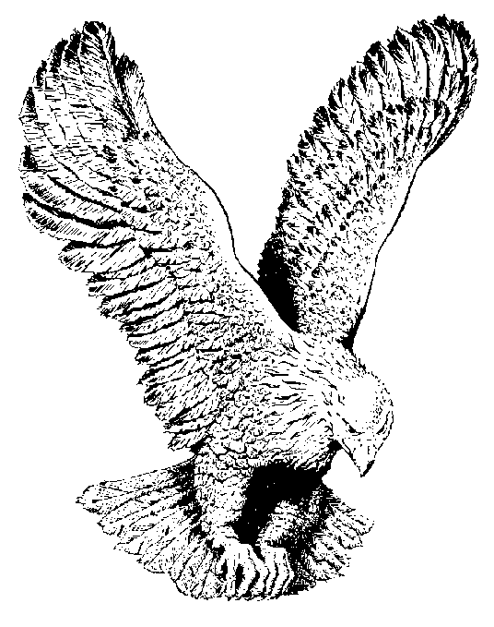
852 ANOINTED OF THE FATHER
Anointed, anointed of the Father
Rose of Sharon fair
Bright and morning star
Lovely, He's altogether lovely
Anointed, anointed of the Lord.

